Slide 1

CS452
Introduction to
Machine Learning
Instructor: Isaac Osei Nyantakyi
Intern: Joel Osei- Asamoah

Slide 2
What is Machine Learning?
“Learning is any process by which a system improves
performance from experience.”
-Herbert Simon
Definition by Tom Mitchell (1998):
Machine Learning is the study of algorithms that
•improve their performance P
•at some task T
•with experience E.
A well-defined learning task is given by <P, T, E>.

Slide 3
Traditional Programming
Data
Program
Computer
Output
Machine Learning
Data
Output
Computer
Program

Slide 4

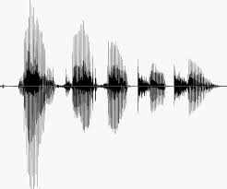
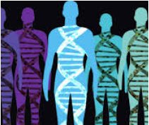
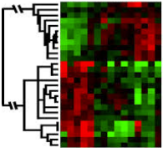
When Do We Use Machine Learning?
ML is usedwhen:
• Human expertisedoesnot exist(navigatingon Mars)
• Humanscan’texplaintheirexpertise(speechrecognition)
• Modelsmustbe customized(personalizedmedicine)
• Modelsarebasedon hugeamountsof data (genomics)
Learning isn’talwaysuseful:
• Thereis noneedto“learn” tocalculatepayroll

Slide 5
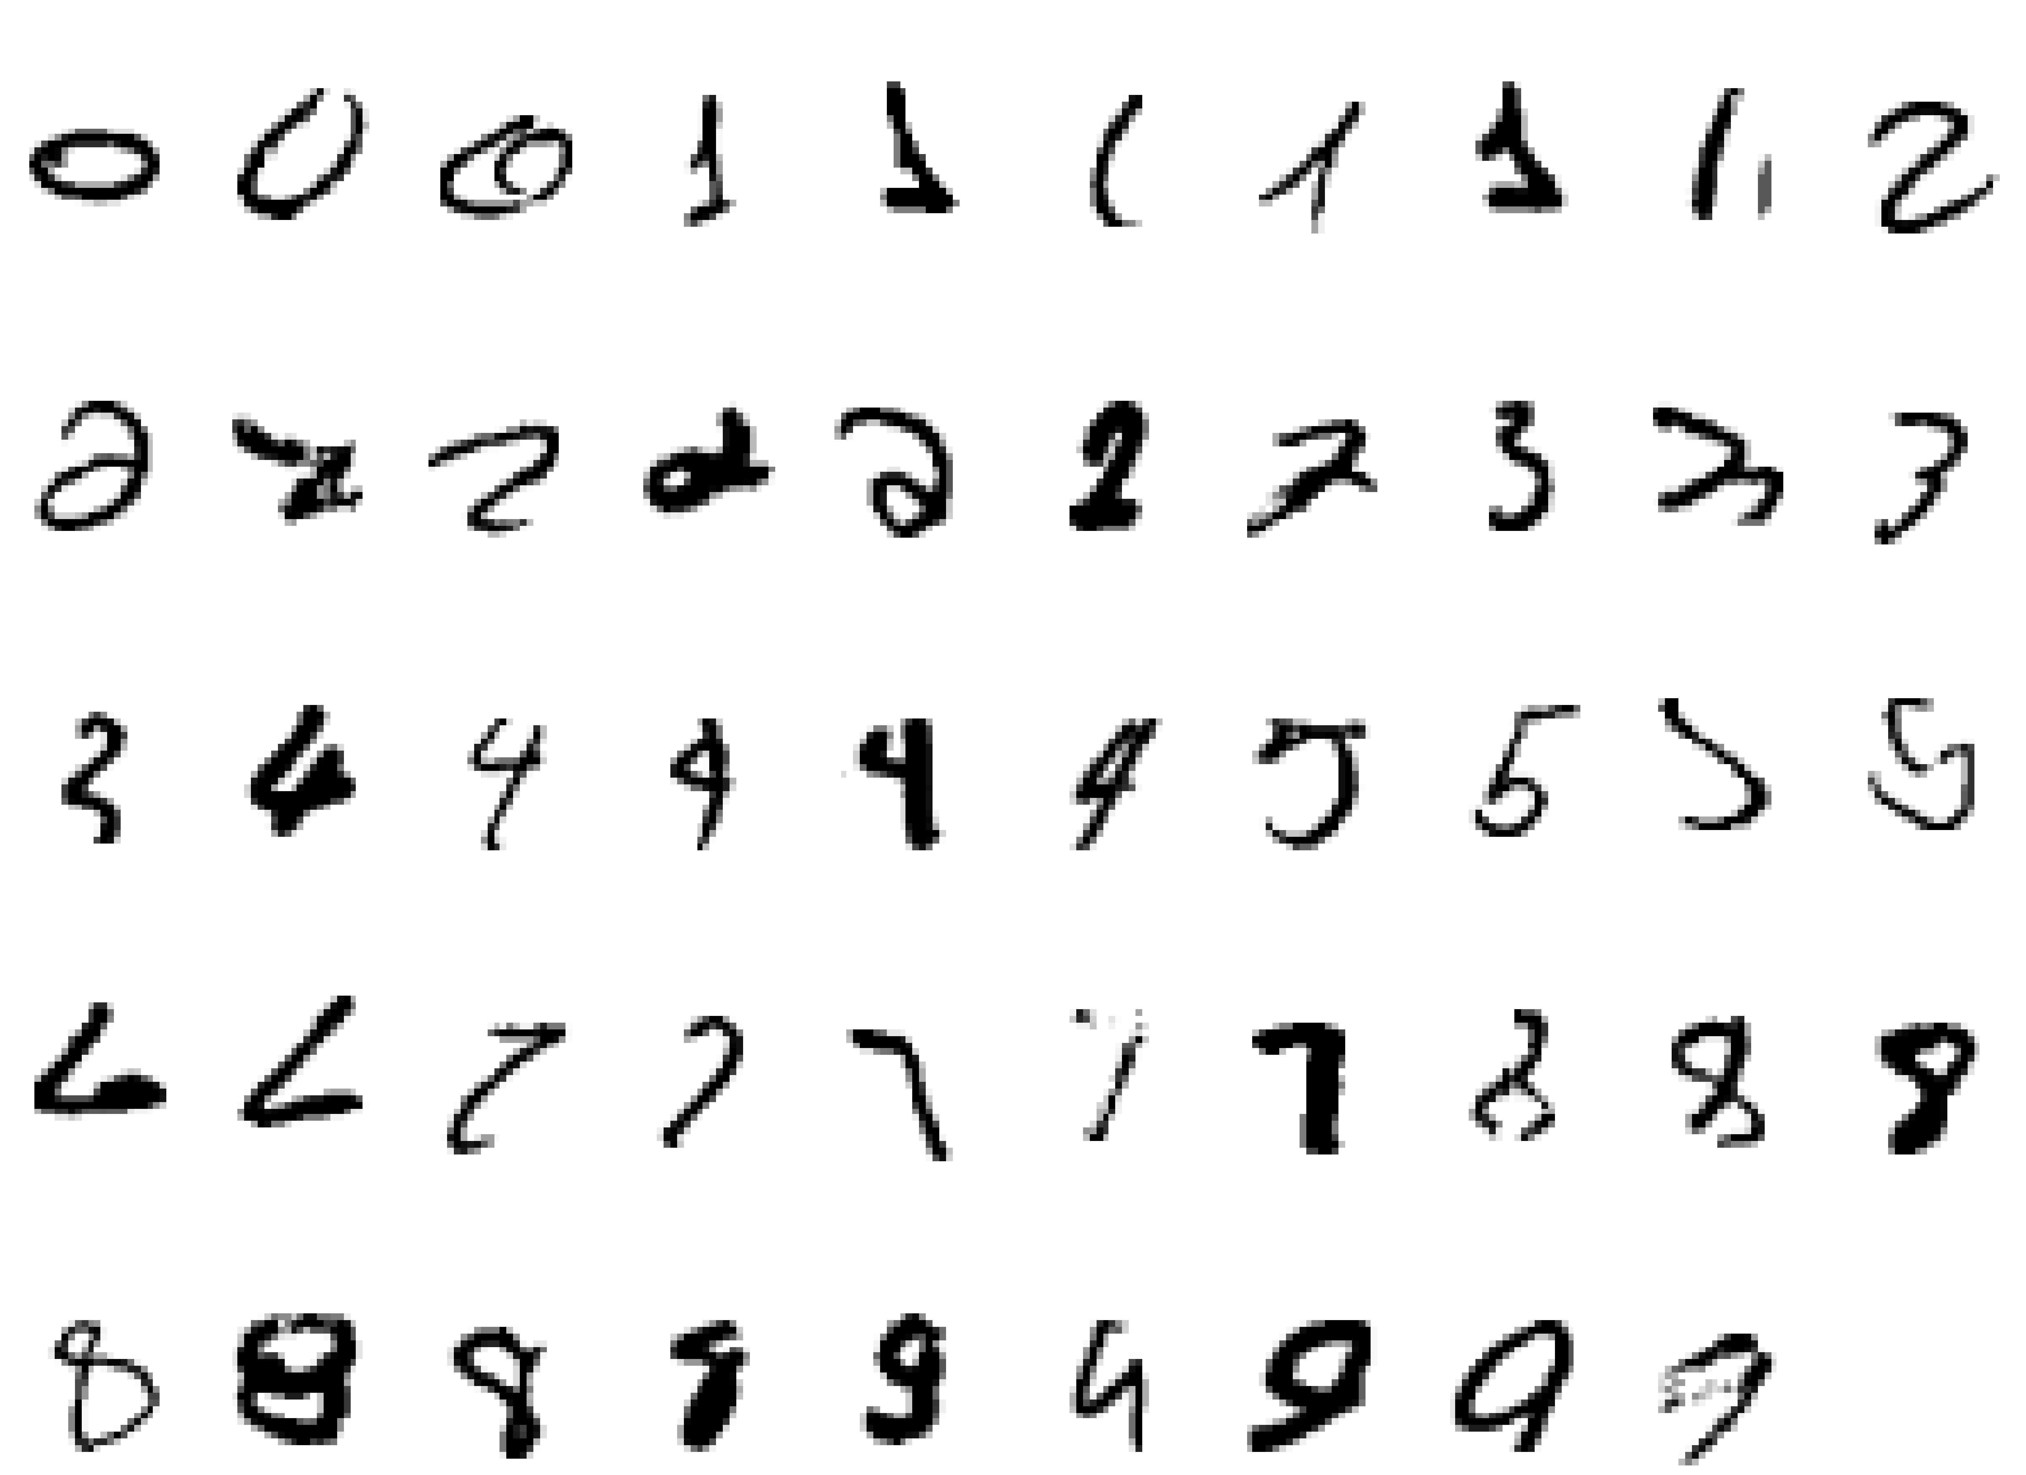
A classic example of a task that requires machine learning:
It is very hard to say what makes a 2

Slide 6
Some more examples of tasks that are best
solved by using a learning algorithm
•Recognizing patterns:
–Facial identities or facial expressions
–Handwritten or spoken words
–Medical images
•Generating patterns:
–Generating images or motion sequences
•Recognizing anomalies:
–Unusual credit card transactions
–Unusual patterns of sensor readings in a nuclear power plant
•Prediction:
–Future stock prices or currency exchange rates

Slide 7
Sample Applications
•Web search
•Computational biology
•Finance
•E-commerce
•Space exploration
•Robotics
•Information extraction
•Social networks
•Debugging software
•[Your favorite area]

Slide 8
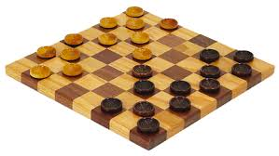
Samuel’s Checkers-Player
“Machine Learning: Field of study that gives
computers the ability to learn without being
explicitly programmed.” -Arthur Samuel (1959)

Slide 9
Defining the Learning Task
Improve on task T, with respect to
performance metric P, based on experience E
T:Playingcheckers
P:Percentageofgameswonagainstanarbitraryopponent
E:Playingpracticegamesagainstitself
T:Recognizinghand-writtenwords
P:Percentageofwordscorrectlyclassified
E:Databaseofhuman-labeledimagesofhandwrittenwords
T:Drivingonfour-lanehighwaysusingvisionsensors
P:Averagedistancetraveledbeforeahuman-judgederror
E:Asequenceofimagesandsteeringcommandsrecordedwhile
observingahumandriver.
T:Categorizeemailmessagesasspamorlegitimate.
P:Percentageofemailmessagescorrectlyclassified.
E:Databaseofemails,somewithhuman-givenlabels

Slide 10
State of the Art Applications of
Machine Learning

Slide 11
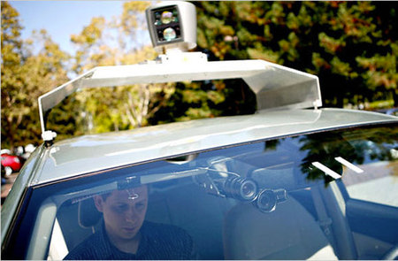
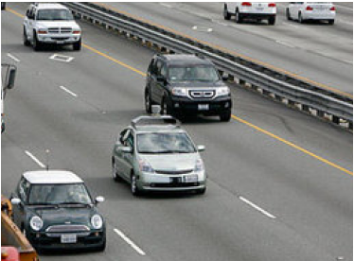
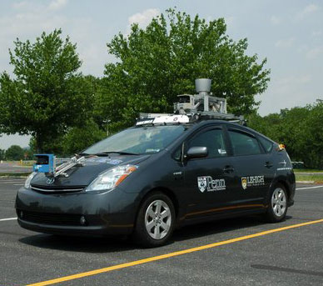
Autonomous Cars
• Nevada made it legal for
autonomous cars to drive on
roads in June 2011
• As of 2013, four states (Nevada,
Florida, California, and
Michigan) have legalized
autonomous cars
Penn’s Autonomous Car à
(Ben Franklin Racing Team)

Slide 12
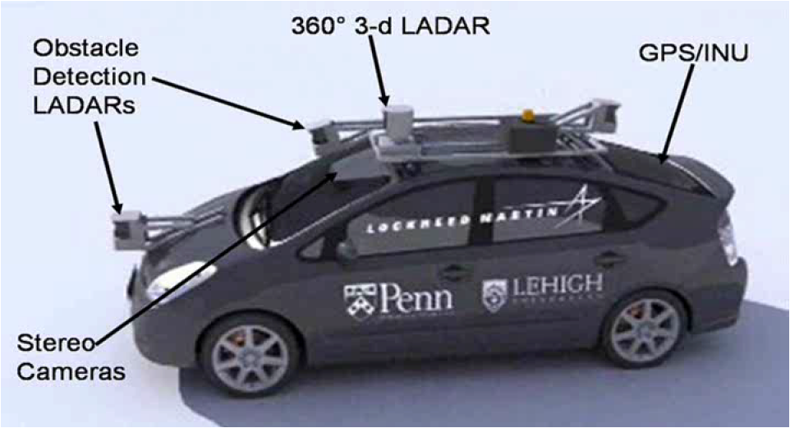
Autonomous Car Sensors

Slide 13
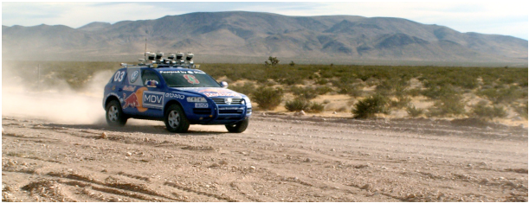
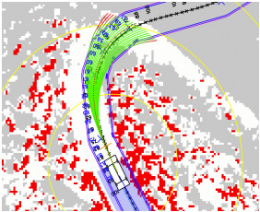
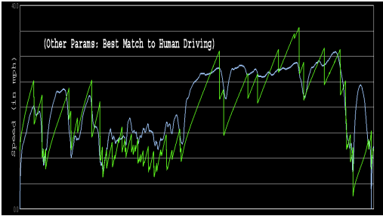
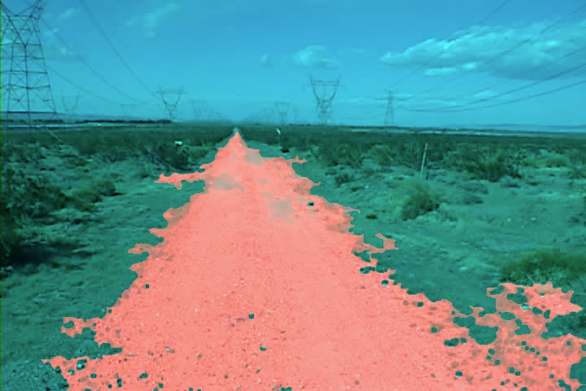
Autonomous Car Technology
Path
Planning
Laser Terrain Mapping
Learning from Human Drivers _{Adaptive Vision}
Sebastian
Stanley
Images and movies taken from Sebastian Thrun’s multimedia website.

Slide 14


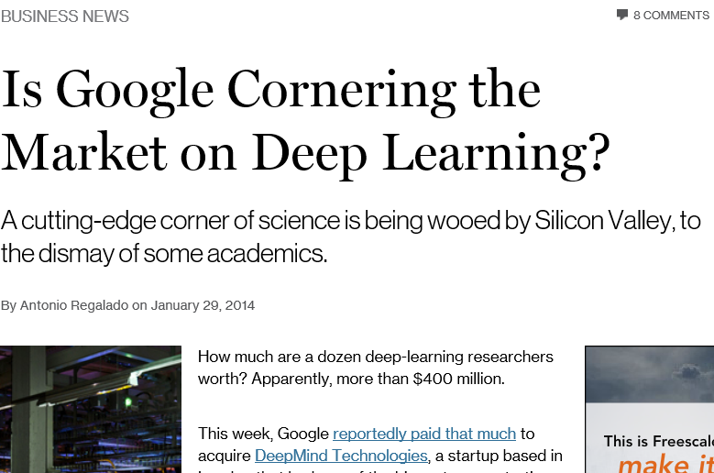
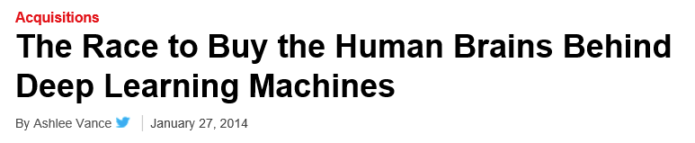
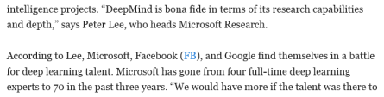
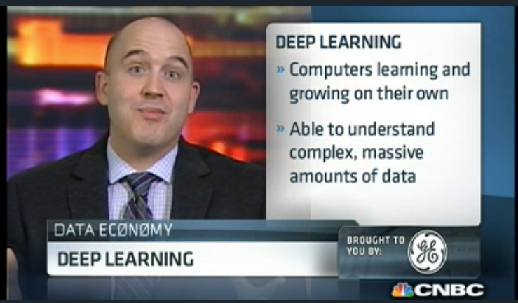
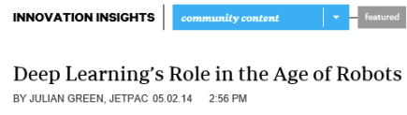
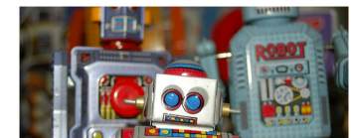
Deep Learning in the Headlines
15

Slide 15
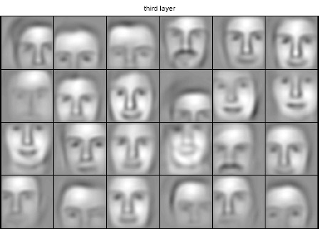
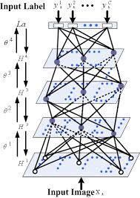

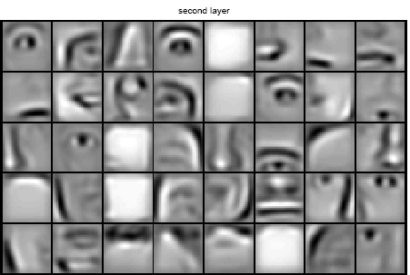


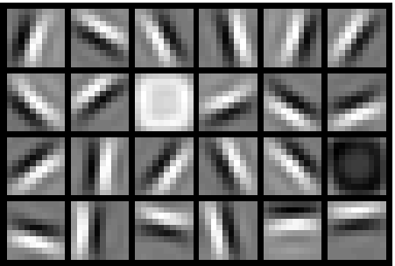
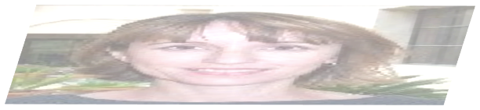

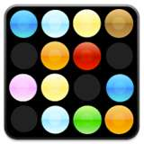
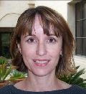
Deep Belief Net on Face Images
object models
object parts
(combination
of edges)
edges
pixels

Slide 16
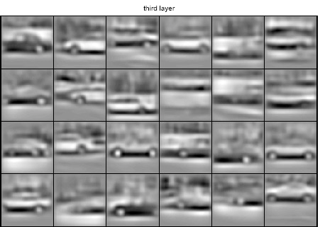
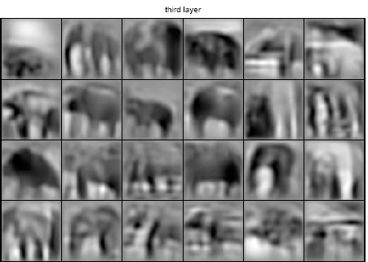
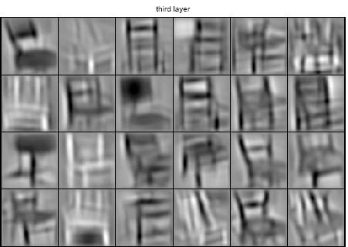
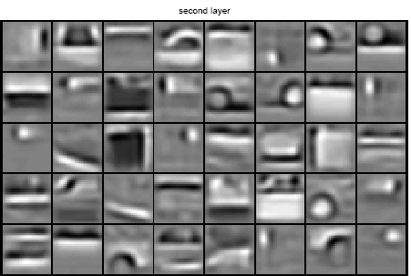
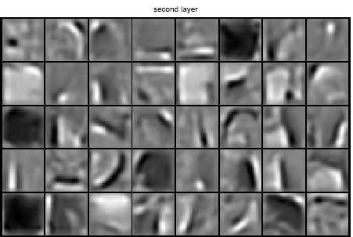
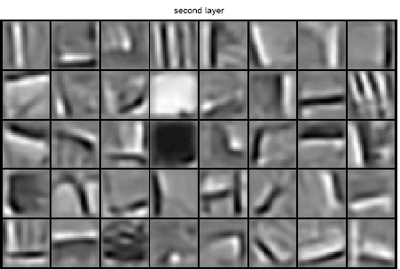
Learning of Object Parts
Examples of learned object parts from object categories
Faces Cars Elephants Chairs

Slide 17
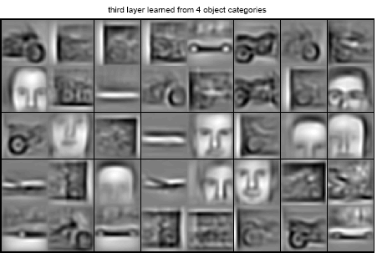
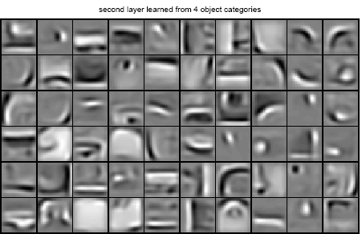
Training on Multiple Objects
Trained on 4 classes (cars, faces,
motorbikes, airplanes).
Second layer: Shared-features
and object-specific features.
Third layer: More specific
features.

Slide 18
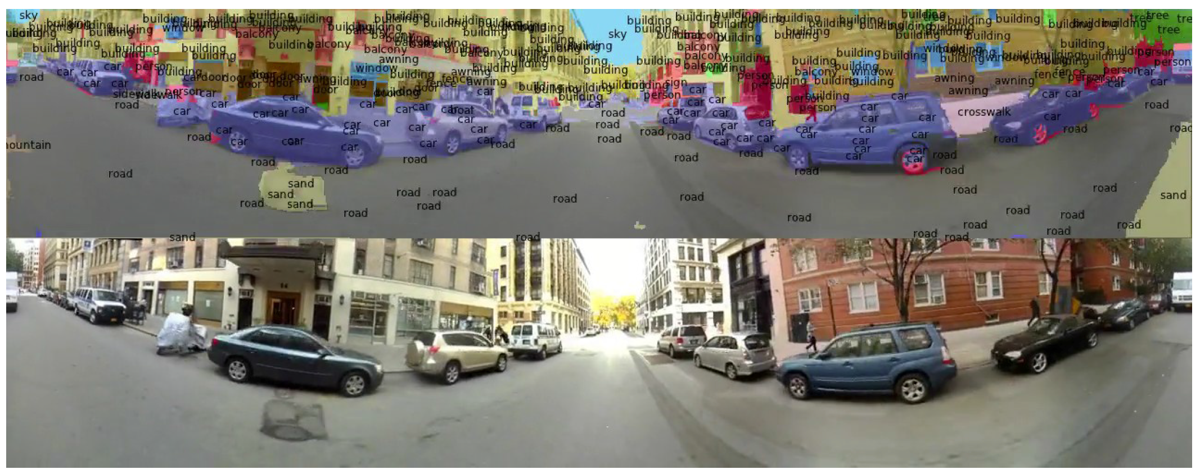
Scene Labeling via Deep Learning
[Farabetet al. ICML 2012, PAMI 2013]

Slide 19
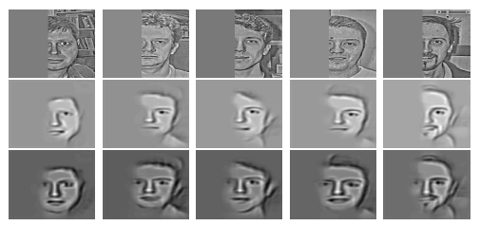
Inference from Deep Learned Models
Generating posterior samples from faces by “filling in”experiments
(cf. Lee and Mumford, 2003). Combine bottom-up and top-down inference.
Input images
Samples from
feedforward
Inference
(control)
Samples from
Full posterior
inference

Slide 20
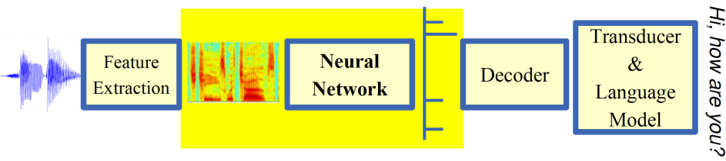
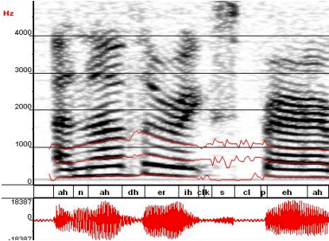
Machine Learning in
Automatic Speech Recognition
A Typical Speech Recognition System
ML used to predict of phone states from the sound spectrogram
Deep learning has state-of-the-art results
#Hidden Layers 1 2 4 8 10 12
Word Error Rate % 16.0 12.8 11.4 10.9 11.0 11.1
Baseline GMM performance = 15.4%
[Zeileret al. “On rectified linear units for speech
recognition” ICASSP 2013]

Slide 21
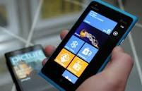
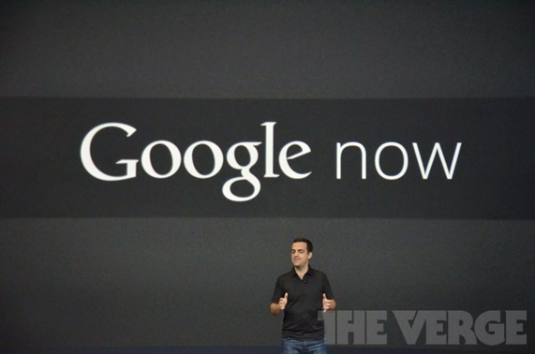
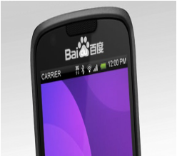
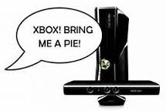

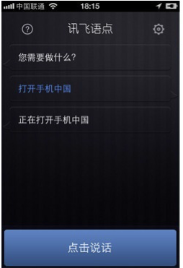
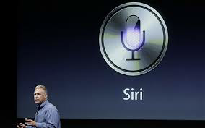
Impact of Deep Learning in Speech Technology

Slide 22
Types of Learning

Slide 23
Types of Learning
•Supervised (inductive) learning
–Given: training data + desired outputs (labels)
•Unsupervised learning
–Given: training data (without desired outputs)
•Semi-supervised learning
–Given: training data + a few desired outputs
•Reinforcement learning
–Rewards from sequence of actions

Slide 24



Supervised Learning: Regression
•Given (x₁, y₁), (x₂, y₂), ..., (x_{n}, y_{n})
•Learn a function f(x) to predict ygiven x
–yis real-valued == regression
9
8
7
6
5
September Arctic Sea Ice Extent
(1,000,000 sq km)
4
3
2
1
0
1970 1980 1990 2000 2010 2020
Year
Data from G. Witt. Journal of Statistics Education, Volume 21, Number 1 (2013)

Slide 25







Supervised Learning: Classification
•Given (x₁, y₁), (x₂, y₂), ..., (x_{n}, y_{n})
•Learn a function f(x) to predict ygiven x
–yis categorical == classification
Breast Cancer (Malignant / Benign)
1(Malignant)
0(Benign)
Tumor Size

Slide 26







Supervised Learning: Classification
•Given (x₁, y₁), (x₂, y₂), ..., (x_{n}, y_{n})
•Learn a function f(x) to predict ygiven x
–yis categorical == classification
Breast Cancer (Malignant / Benign)
1(Malignant)
0(Benign)
Tumor Size

Slide 27
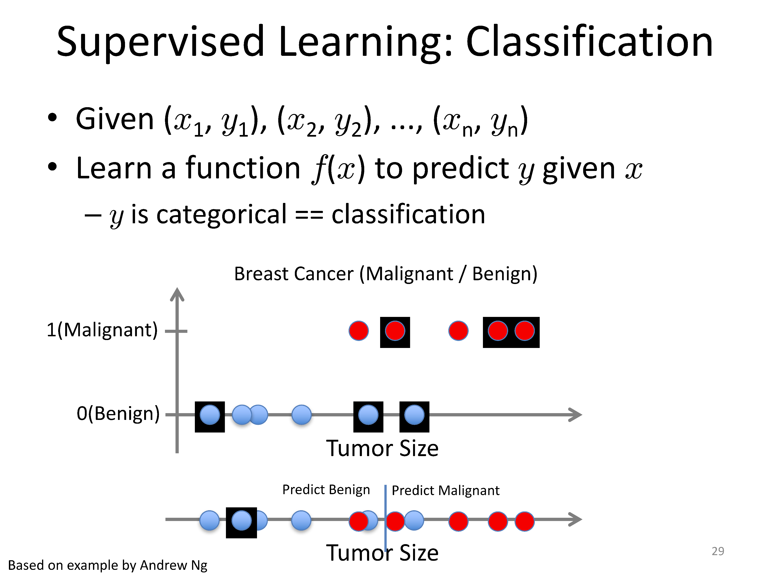

Slide 28










Supervised Learning
•x can be multi-dimensional
–Each dimension corresponds to an attribute
- Clump Thickness
- Uniformity of Cell Size
- Uniformity of Cell Shape
Age
…
Tumor Size

Slide 29






















Unsupervised Learning
•Given x₁, x₂, ..., x_{n} (without labels)
•Output hidden structure behind the x’s
–E.g., clustering

Slide 30
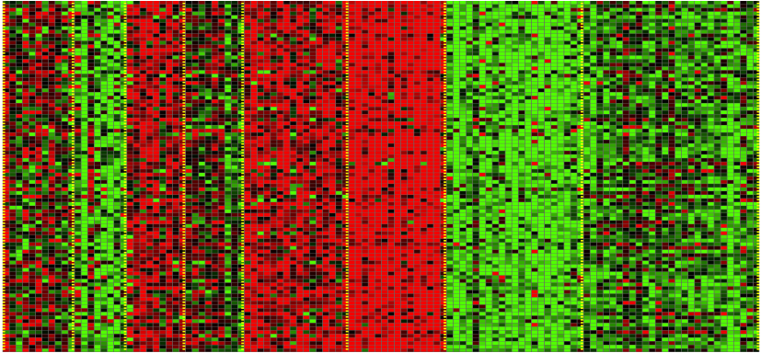
Unsupervised Learning
Genomics application: group individuals by genetic similarity
Genes
Individuals
[Source: Daphne Koller]

Slide 31

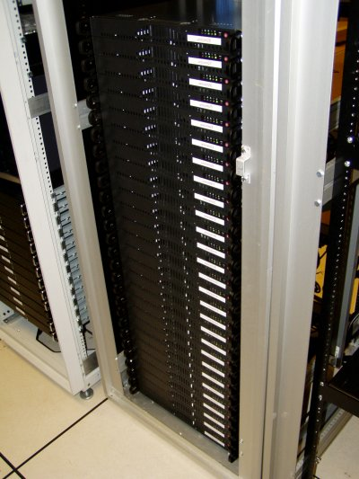
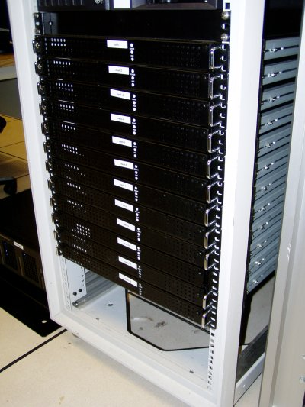


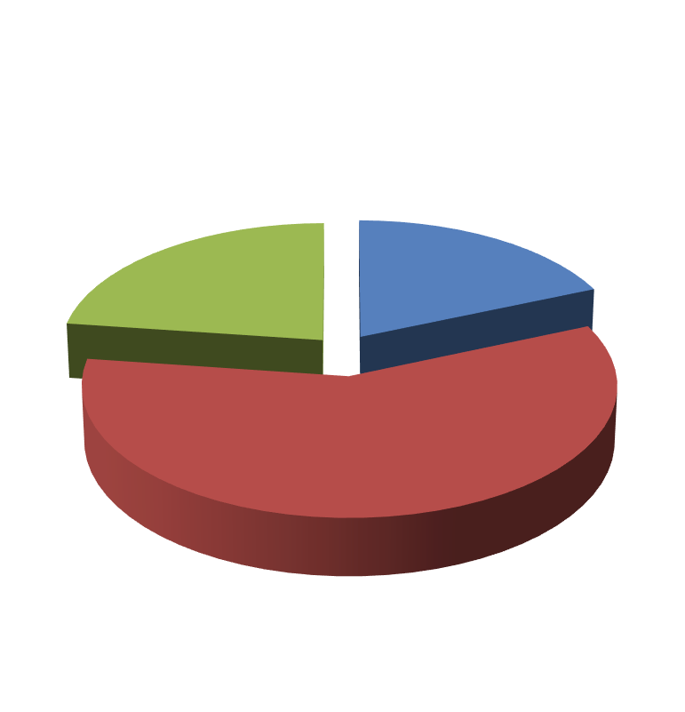

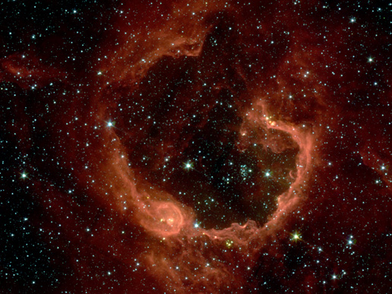


Unsupervised Learning
Organize computing clusters Social network analysis
Image credit: NASA/JPL-Caltech/E. Churchwell(Univ. of Wisconsin, Madison)
^{Market segmentation} Astronomical data analysis

Slide 32


Unsupervised Learning
•Independent component analysis –separate a
combined signal into its original sources
Image credit: statsoft.comAudio from http://www.ism.ac.jp/~shiro/research/blindsep.html

Slide 33
Reinforcement Learning
•Givena sequenceof statesandactionswith
(delayed) rewards, outputa policy
–Policyis a mappingfromstatesàactionsthat
tellsyouwhattodo in a givenstate
•Examples:
–Creditassignmentproblem
–Game playing
–Robot in a maze
–Balance a pole on your hand

Slide 34




The Agent-Environment Interface
Agent and environment interact at discrete time steps : t=0,1,2,K
Agent observes state at step t: s_{t}$∈$S
produces action at step t: a_{t} $∈$A(s_{t})
gets resulting reward: r_{t+1} $∈ ℜ$
and resulting next state: s_{t+1}
. . . _{st a} ^{r}t+1_{st +1}
r_{t+2 s}
r_{t+3 s}
t +2
t +3
. . .
t
ªt+1
ªt+2
ªt+3

Slide 35

Reinforcement Learning
https://www.youtube.com/watch?v=4cgWya-wjgY
Notes:
This is an example video of a successful attempt to learn an optimal policy for a more challenging level that contains coins, hidden blocks and normal blocks, obstacles, and enemies. This work was done at the University of Oklahoma in the course C S-4033/5033 - Machine Learning in the Fall Semester of 2010.

Slide 36


Inverse Reinforcement Learning
•Learn policy from user demonstrations
Stanford Autonomous Helicopter
http://heli.stanford.edu/
https://www.youtube.com/watch?v=VCdxqn0fcnE

Slide 37
Framing a Learning Problem

Slide 38




Designing a Learning System
•Choose the training experience
•Choose exactly what isto be learned
–i.e. the target function
•Choose how to represent the targetfunction
•Choose a learning algorithm to infer the target
function from the experience
Training data
Learner
Environment/
Experience
Knowledge
Testing data
Performance
Element

Slide 39
Training vs. Test Distribution
•We generally assume that the training and
test examples are independently drawn from
the same overall distribution of data
–We call this “i.i.d” which stands for “independent
and identically distributed”
•If examples are not independent, requires
collective classification
•If test distribution is different, requires
transfer learning

Slide 40
ML in a Nutshell
•Tens of thousands of machine learning
algorithms
–Hundreds new every year
•Every ML algorithm has three components:
–Representation
–Optimization
–Evaluation

Slide 41
Various Function Representations
• Numerical functions
– Linear regression
– Neural networks
– Support vector machines
• Symbolic functions
– Decision trees
– Rules in propositional logic
– Rules in first-order predicate logic
• Instance-based functions
– Nearest-neighbor
– Case-based
• Probabilistic Graphical Models
– Naïve Bayes
– Bayesian networks
– Hidden-Markov Models (HMMs)
– Probabilistic Context Free Grammars (PCFGs)
– Markov networks

Slide 42
Various Search/Optimization
Algorithms
• Gradient descent
–Perceptron
–Backpropagation
• Dynamic Programming
–HMM Learning
–PCFG Learning
• Divide and Conquer
–Decision tree induction
–Rule learning
• Evolutionary Computation
–Genetic Algorithms (GAs)
–Genetic Programming (GP)
–Neuro-evolution

Slide 43
Evaluation
•Accuracy
•Precision and recall
•Squared error
•Likelihood
•Posterior probability
•Cost / Utility
•Margin
•Entropy
•K-L divergence
•etc.

Slide 44




ML in Practice
• Understand domain, prior knowledge, and goals
• Data integration, selection, cleaning, pre-processing, etc.
• Learn models
Loop
• Interpret results
• Consolidate and deploy discovered knowledge

Slide 45
Lessons Learned about Learning
•Learning can be viewed as using direct or indirect
experience to approximate a chosen target function.
•Function approximation can be viewed as a search
through a space of hypotheses (representations of
functions) for one that best fits a set of training data.
•Different learning methods assume different
hypothesis spaces (representation languages) and/or
employ different search techniques.

Slide 46
A Brief History of
Machine Learning

Slide 47
History of Machine Learning
• 1950s
– Samuel’s checker player
– Selfridge’s Pandemonium
• 1960s:
– Neural networks: Perceptron
– Pattern recognition
– Learning in the limit theory
– Minskyand Papertprove limitations of Perceptron
• 1970s:
– Symbolic concept induction
– Winston’s arch learner
– Expert systems and the knowledge acquisition bottleneck
– Quinlan’s ID3
– Michalski’sAQ and soybean diagnosis
– Scientific discovery with BACON
– Mathematical discovery with AM

Slide 48
History of Machine Learning (cont.)
• 1980s:
– Advanced decision tree and rule learning
– Explanation-based Learning (EBL)
– Learning and planning and problem solving
– Utility problem
– Analogy
– Cognitive architectures
– Resurgence of neural networks (connectionism, backpropagation)
– Valiant’sPAC Learning Theory
– Focus on experimental methodology
• 1990s
– Data mining
– Adaptive software agents and web applications
– Text learning
– Reinforcement learning (RL)
– Inductive Logic Programming (ILP)
– Ensembles: Bagging, Boosting, and Stacking
– Bayes Net learning

Slide 49
History of Machine Learning (cont.)
• 2000s
–Support vector machines & kernel methods
–Graphical models
–Statistical relational learning
–Transfer learning
–Sequence labeling
–Collective classification and structured outputs
–Computer Systems Applications (Compilers, Debugging, Graphics, Security)
–E-mail management
–Personalized assistants that learn
–Learning in robotics and vision
• 2010s
–Deep learning systems
–Learning for big data
–Bayesian methods
–Multi-task & lifelong learning
–Applications to vision, speech, social networks, learning to read, etc.
–???

Slide 50

What We’ll Cover in this Course
•Supervised learning
–Decision tree induction
•Unsupervised learning
–Clustering
–Dimensionality reduction
–Linear regression
–Logistic regression
–Support vector machines
•Reinforcement learning
–Temporal difference
& kernel methods
–Model ensembles
–Bayesian learning
–Neural networks & deep
learning
–Q learning
•Evaluation
•Applications
learning
–Learning theory
Our focus will be on applying machine learning to real applications

